Slide 1
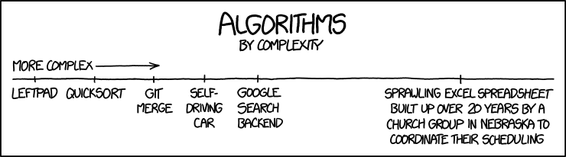
The Gaussian elimination and its applications in SageMath
Proseminar on computer-assisted mathematics,
Petr Samodelkin and Elias Köhnlein
Gauss algorithm

Slide 2
Presentation Structure
Gauss Method
Introduction to necessity of the algorithm
Explanation of the code
Coded Applications and Comparisons to In-Built Sage Functions
Linear equations
Inverting matrices
Row span
Determinant

Slide 3
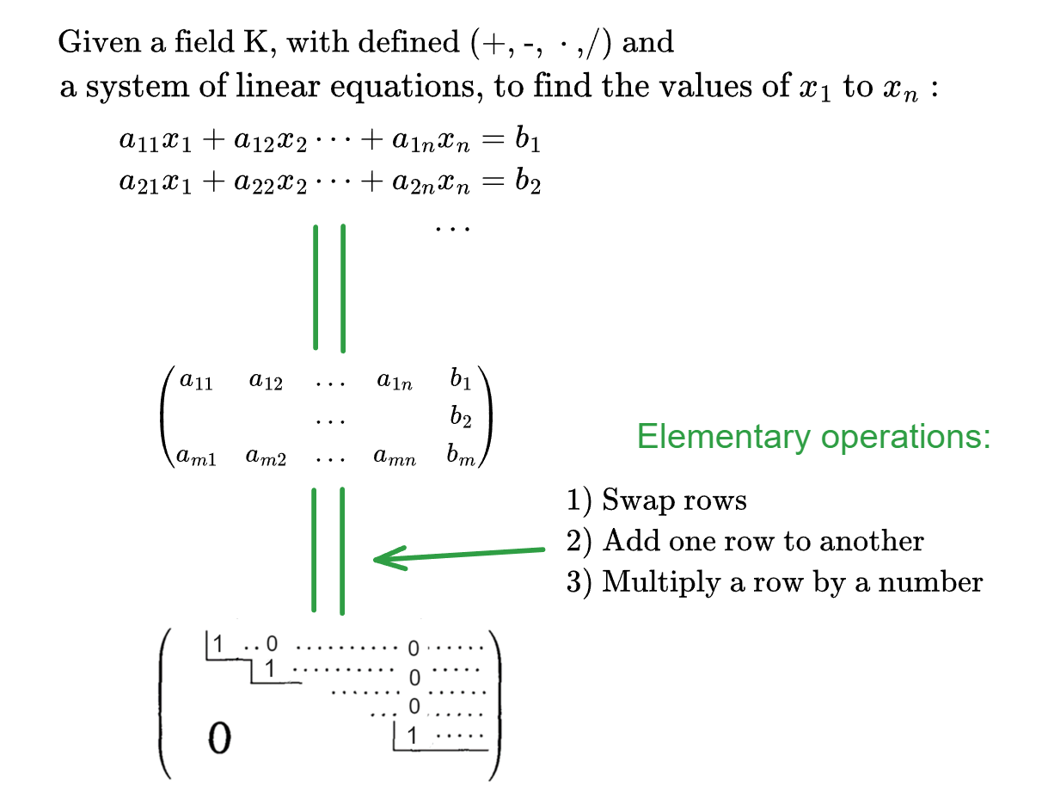
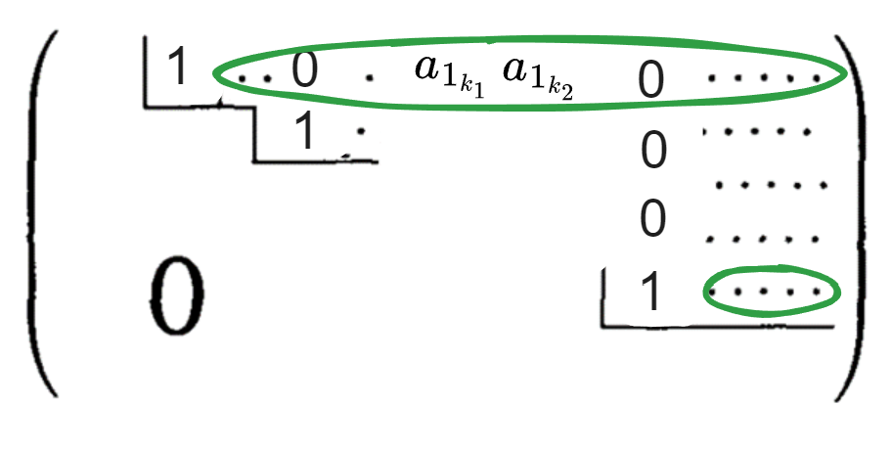
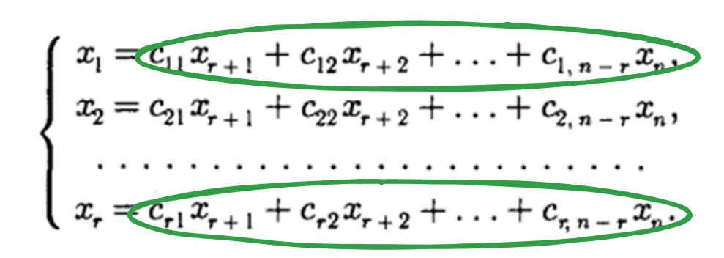
Solving a Linear Equations System

Slide 4
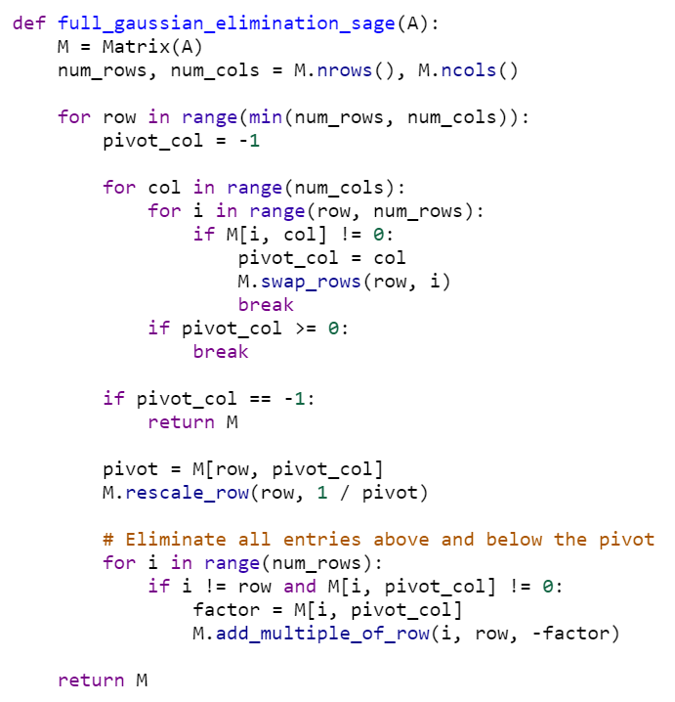
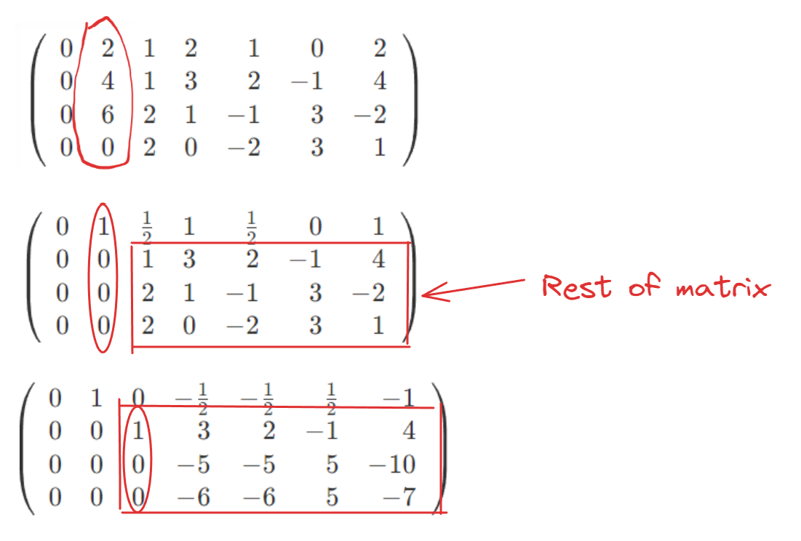
The Gauss method: code

Slide 5
Presentation Structure
Gauss Method
Introduction to necessity of the algorithm
Explanation of the code
Coded Applications and Comparisons to In-Built Sage Functions
Linear equations
Inverting matrices
Row span
Determinant

Slide 6
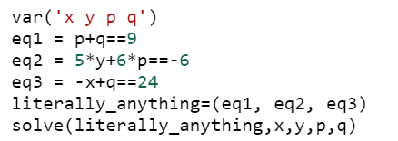
Linear equations: code
Our implementation
Sage’s “solve”
We have a truly marvelous piece of code that this slide or Jupyter notebook is too narrow to contain.
Pierre de Fermat Elias and Petr
Vastly superior to our method, as it solves any system of equations, but handles the linear ones too:

Slide 7
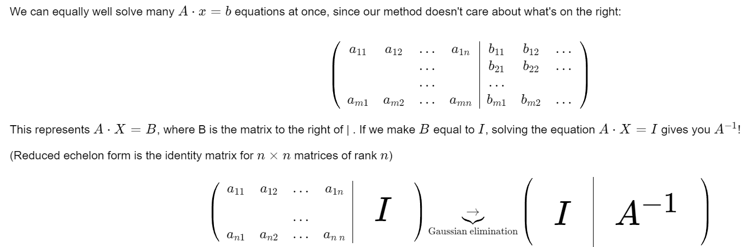
Inverting matrices: Theory

Slide 8
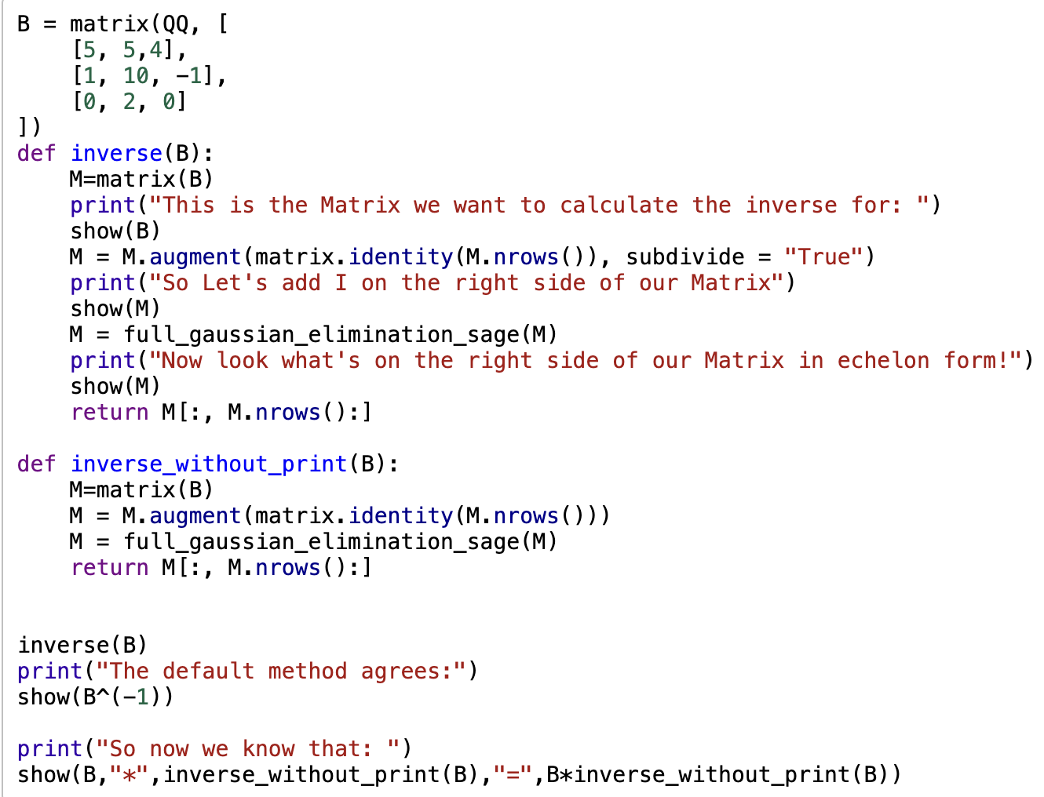
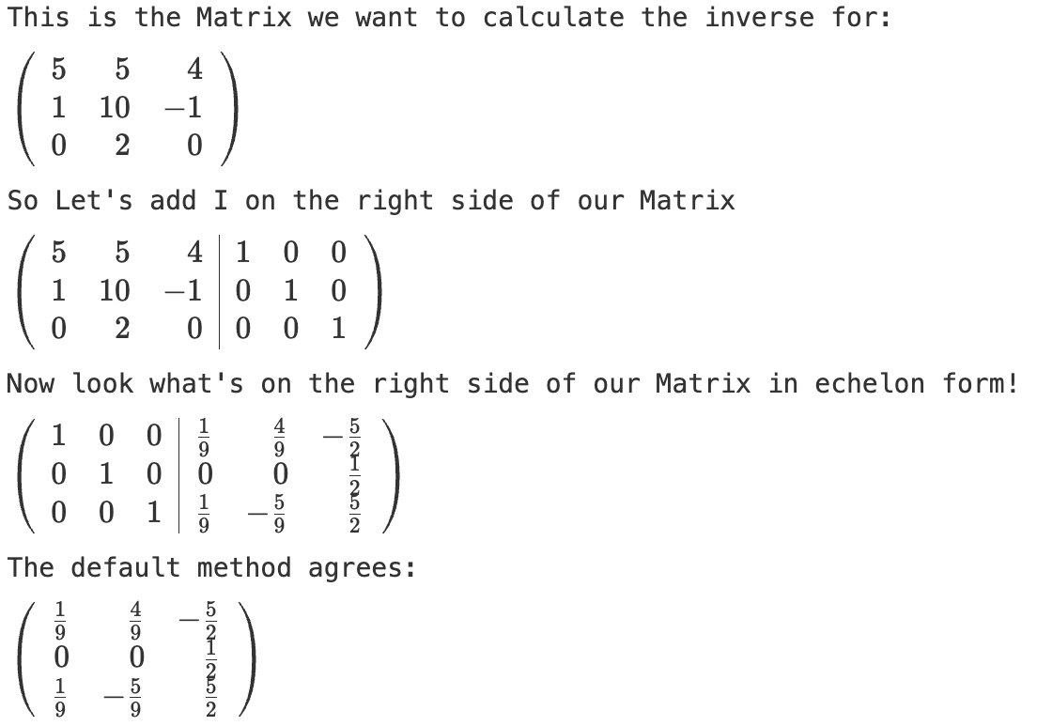
Inverting matrices: The code
B^x also allows you to raise B to any power!

Slide 9
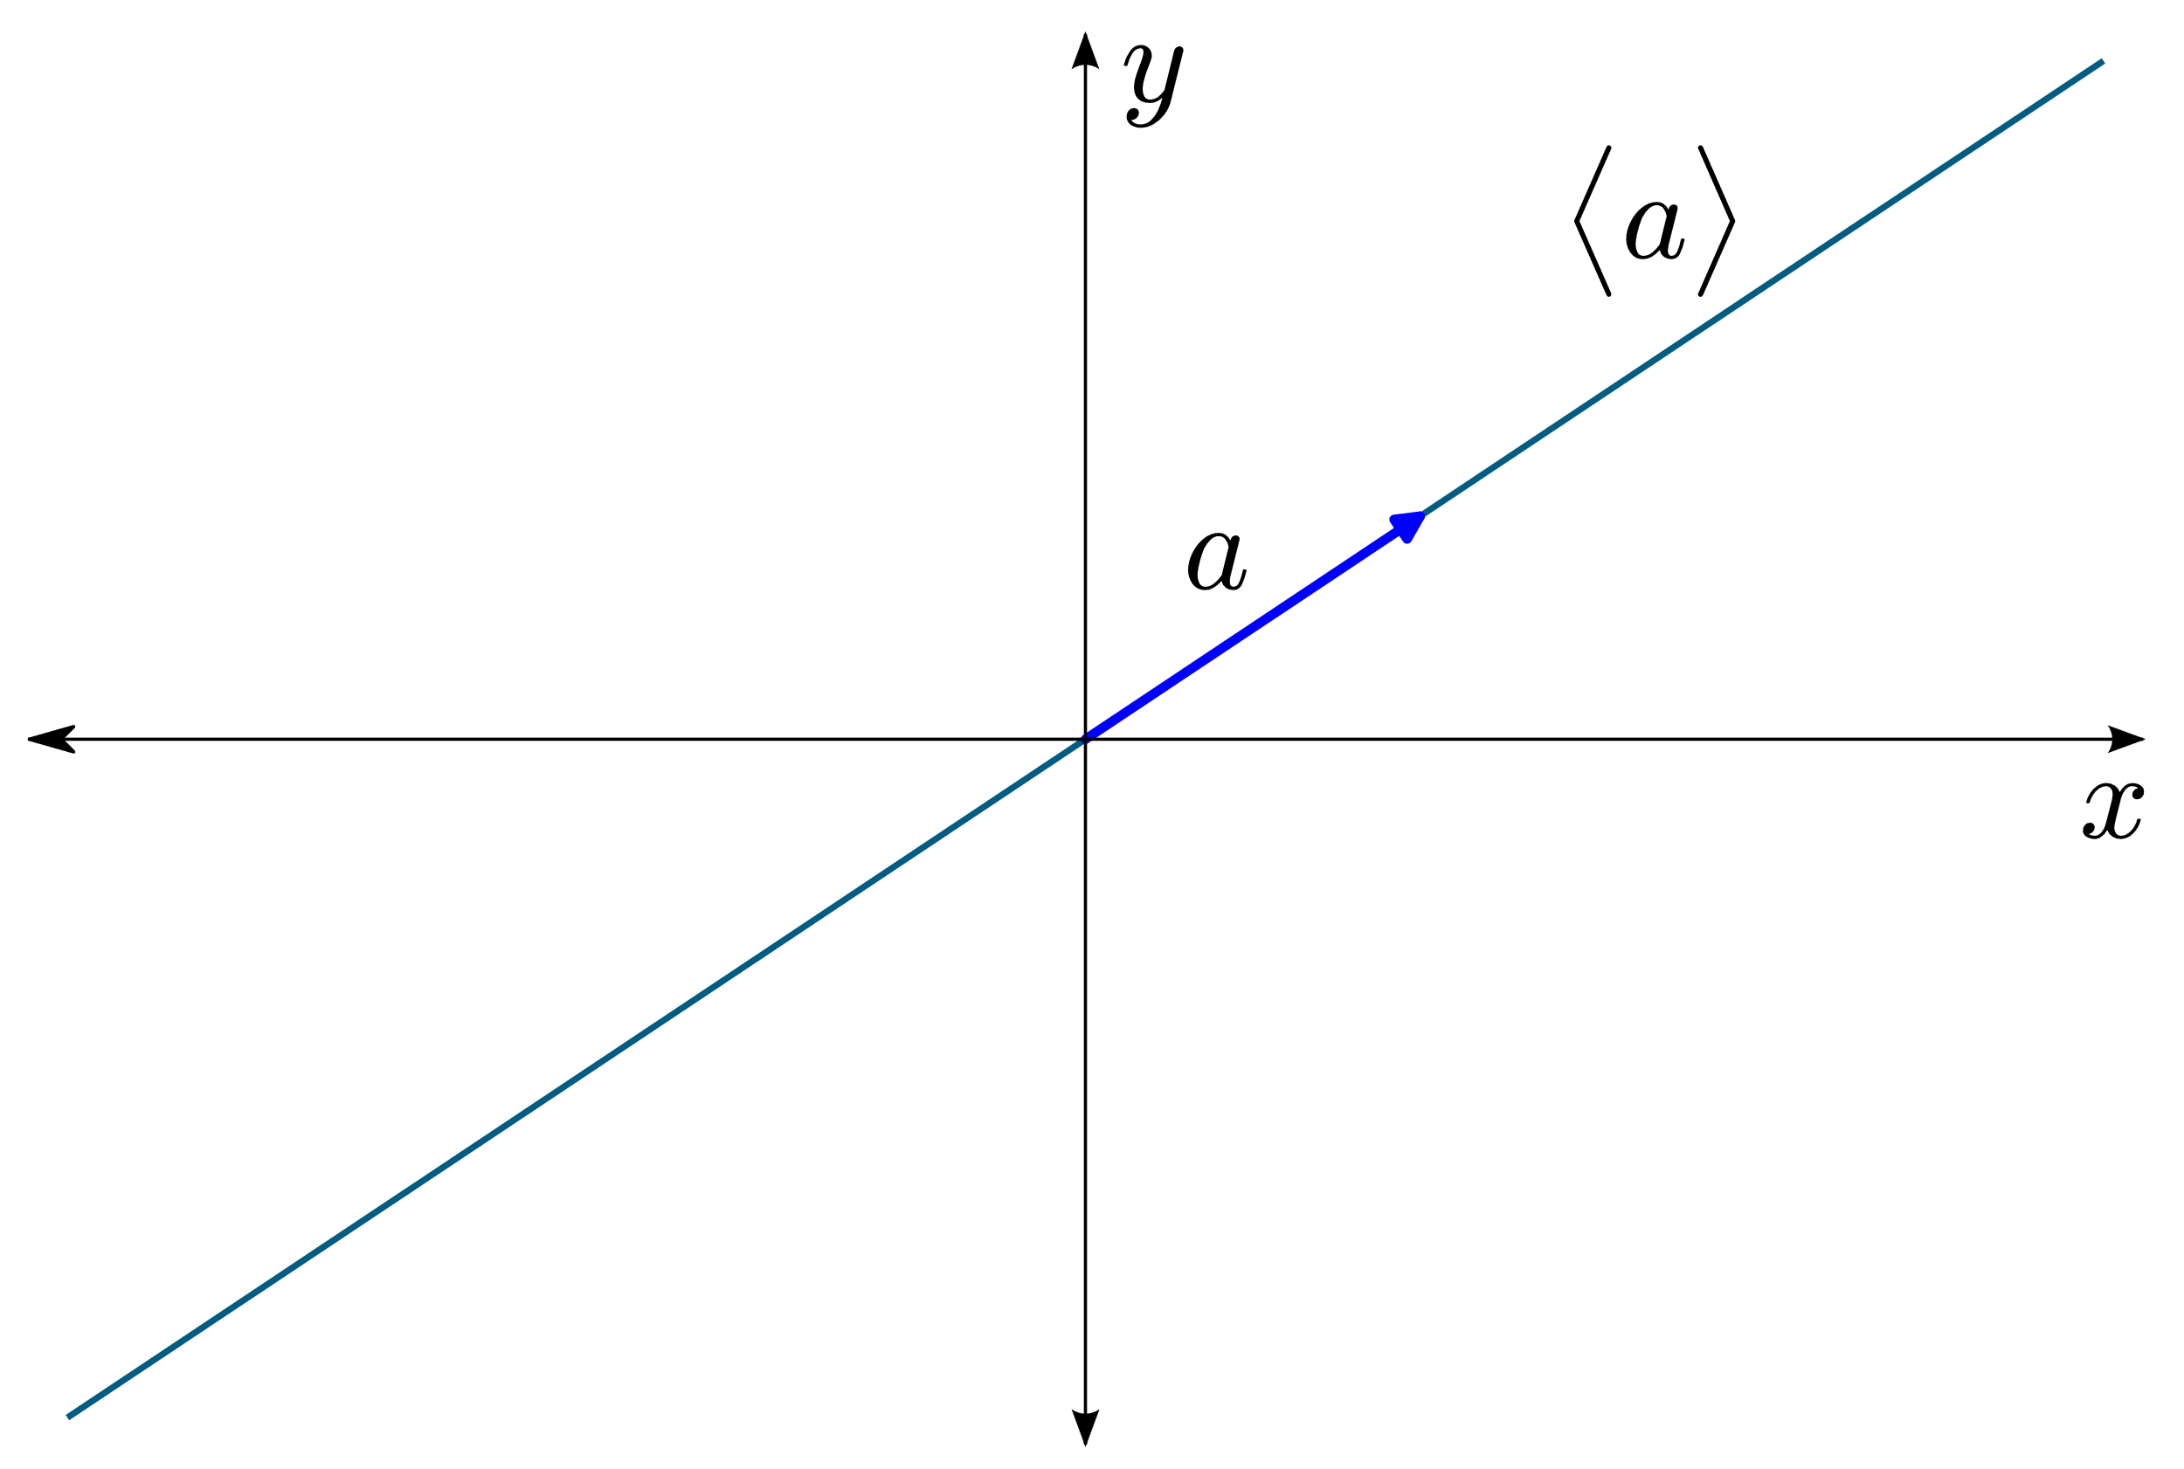
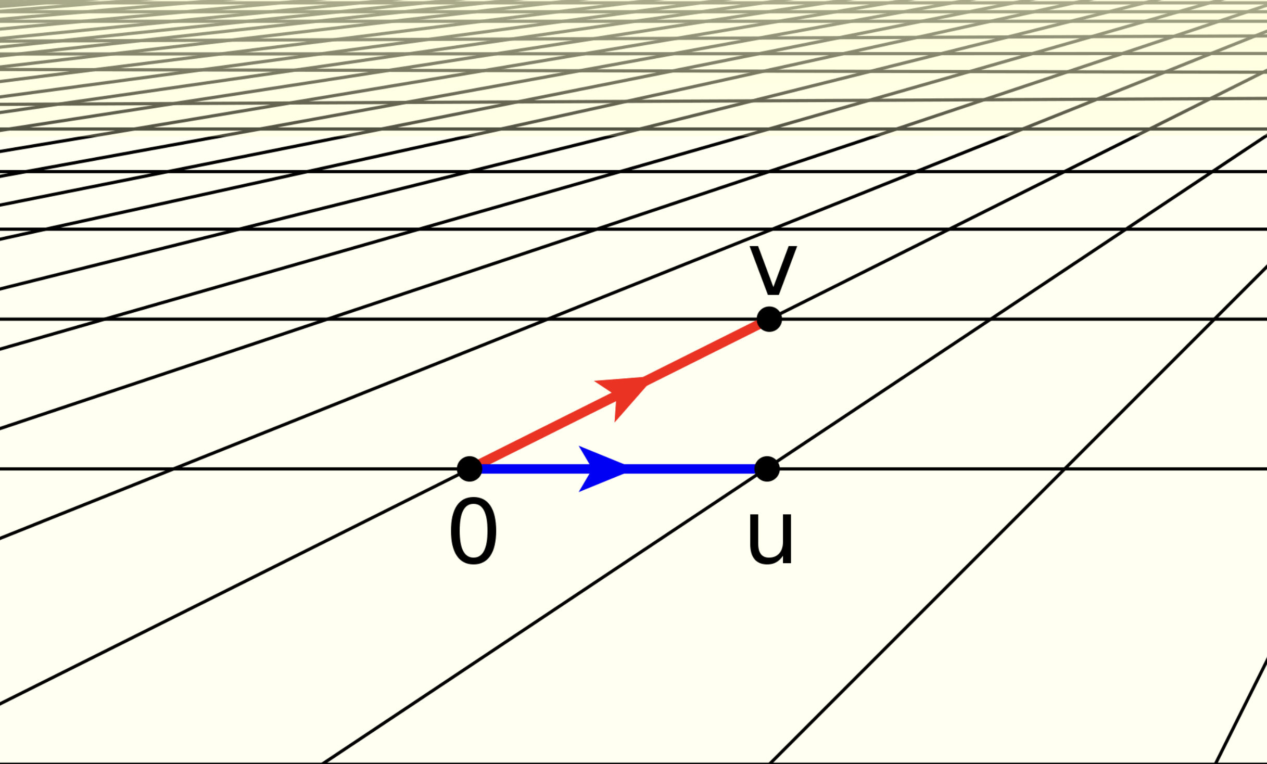
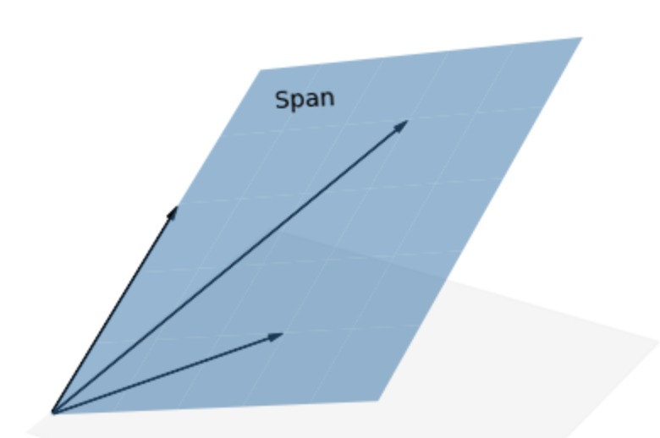
Row span
Elementary row operations don’t change the linear dependence of the row vectors!

Slide 10
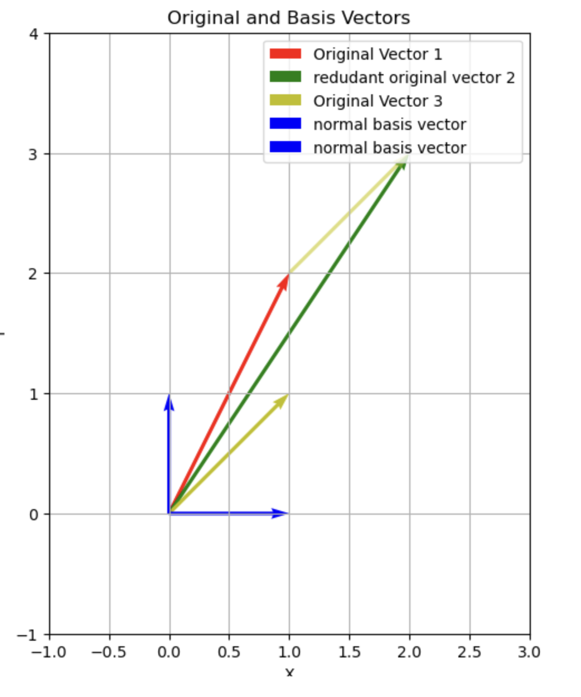
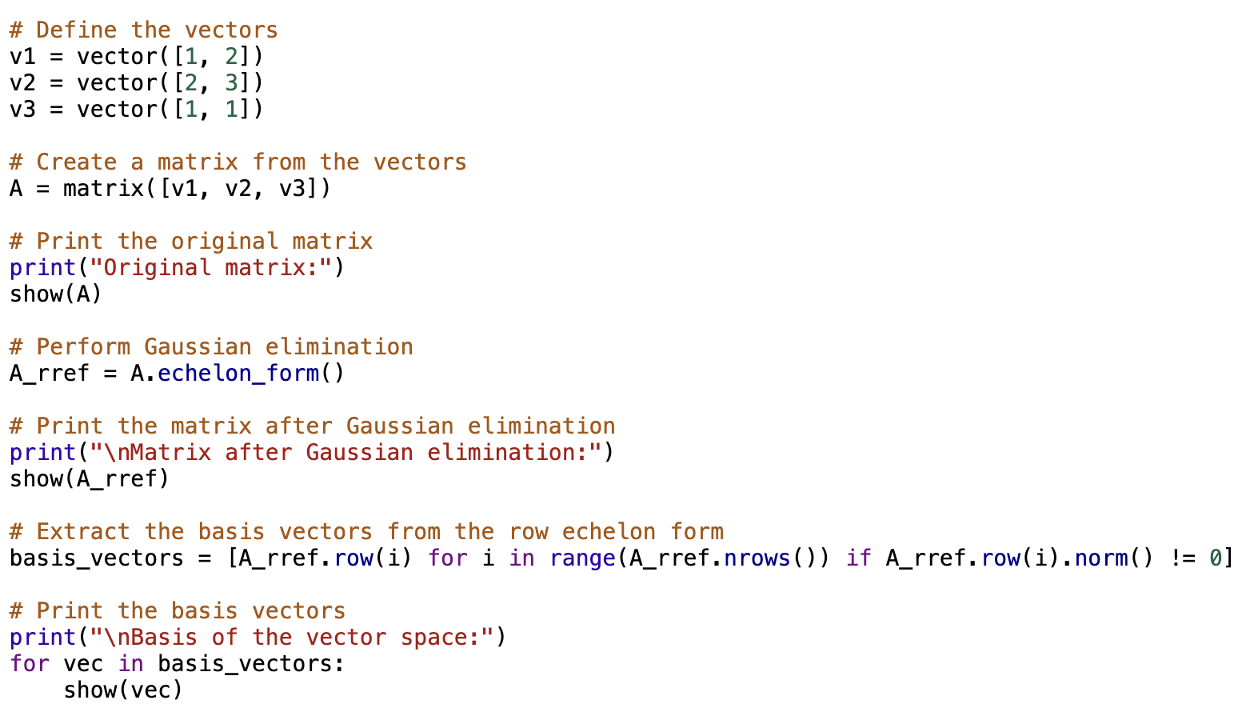
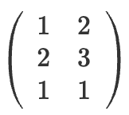

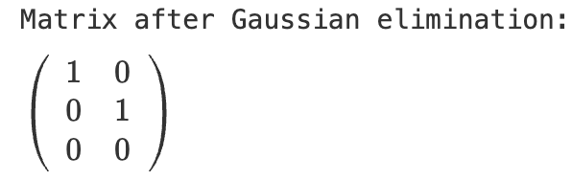
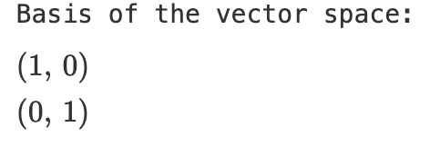
Notes:
A_rref.row(i) retrieves the i-th row vector of the matrix A_rref.
for i in range(A_rref.nrows()) iterates over each row index i of the matrix.
if A_rref.row(i).norm() != 0 checks if the norm (length) of the i-th row vector is not equal to zero.
[A_rref.row(i) for i in range(A_rref.nrows()) if A_rref.row(i).norm() != 0] constructs a list comprehension that builds a list containing all row vectors of A_rref that have a nonzero norm.

Slide 11
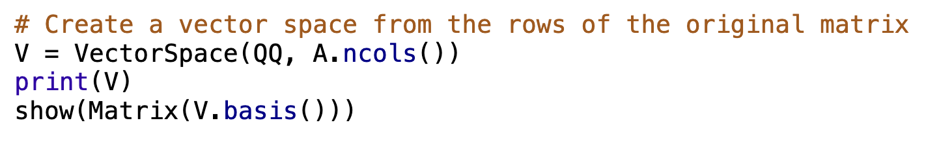
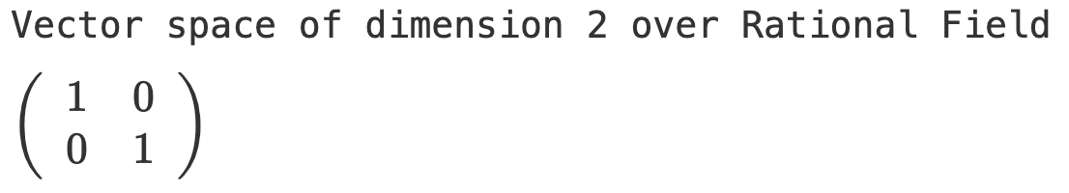

Slide 12
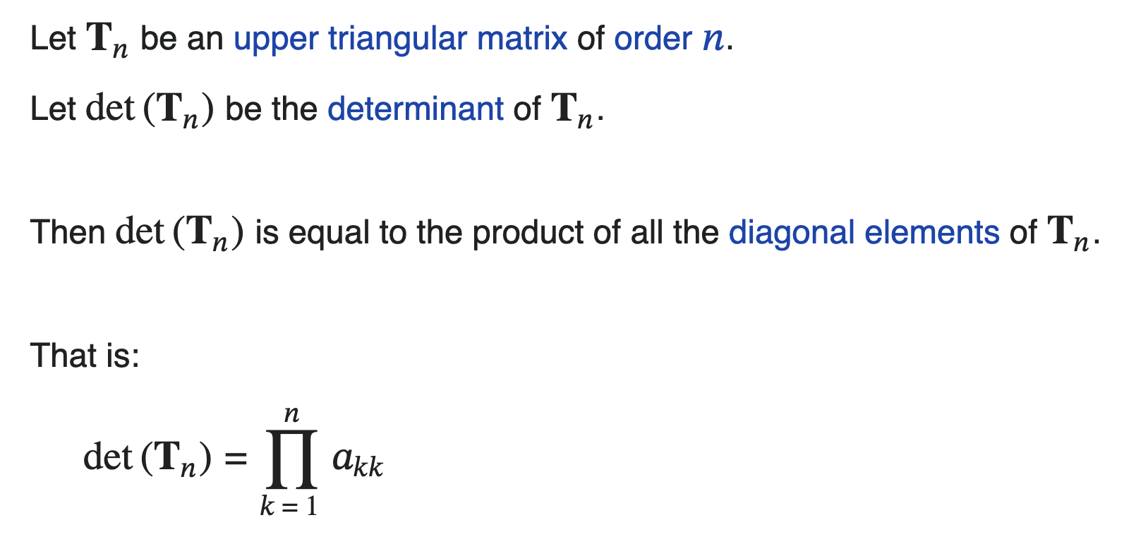
Calculating the Determinant of a Matrix
Notes:
There is only one pattern which will not contain a 0 and this the pattern of the entries on the diagonal, which you can see by Laplace’s expansion: the only nonzero entry in the first row would be a11, next for the determinant of the minor A11 again by Laplace - the only nonzero entry of its first row is a22 and so on. So we can say that the determinant of a triangular matrix is the product of the entries on the diagonal, det A = a11a22a33 . . . ann .

Slide 13
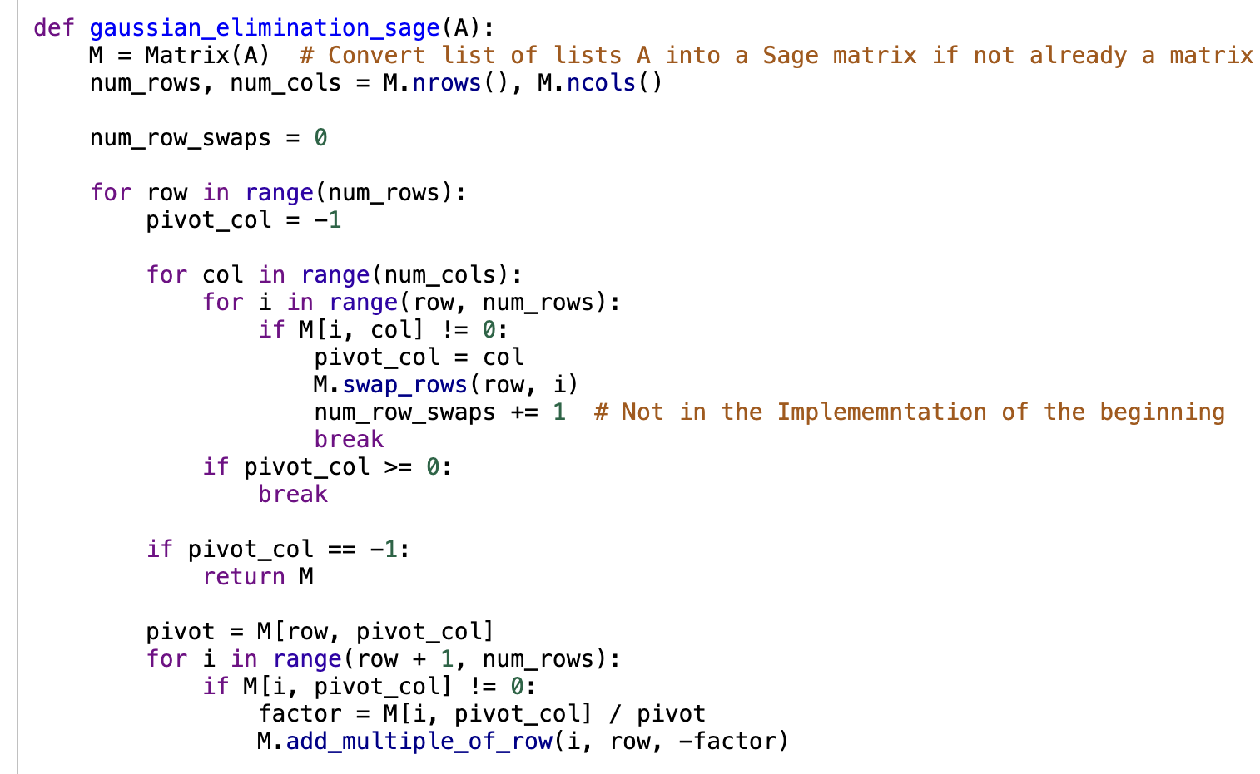
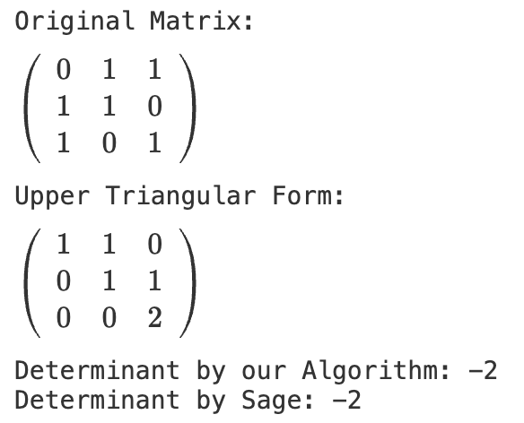
Code to calculate the Determinant of a Matrix

Slide 14
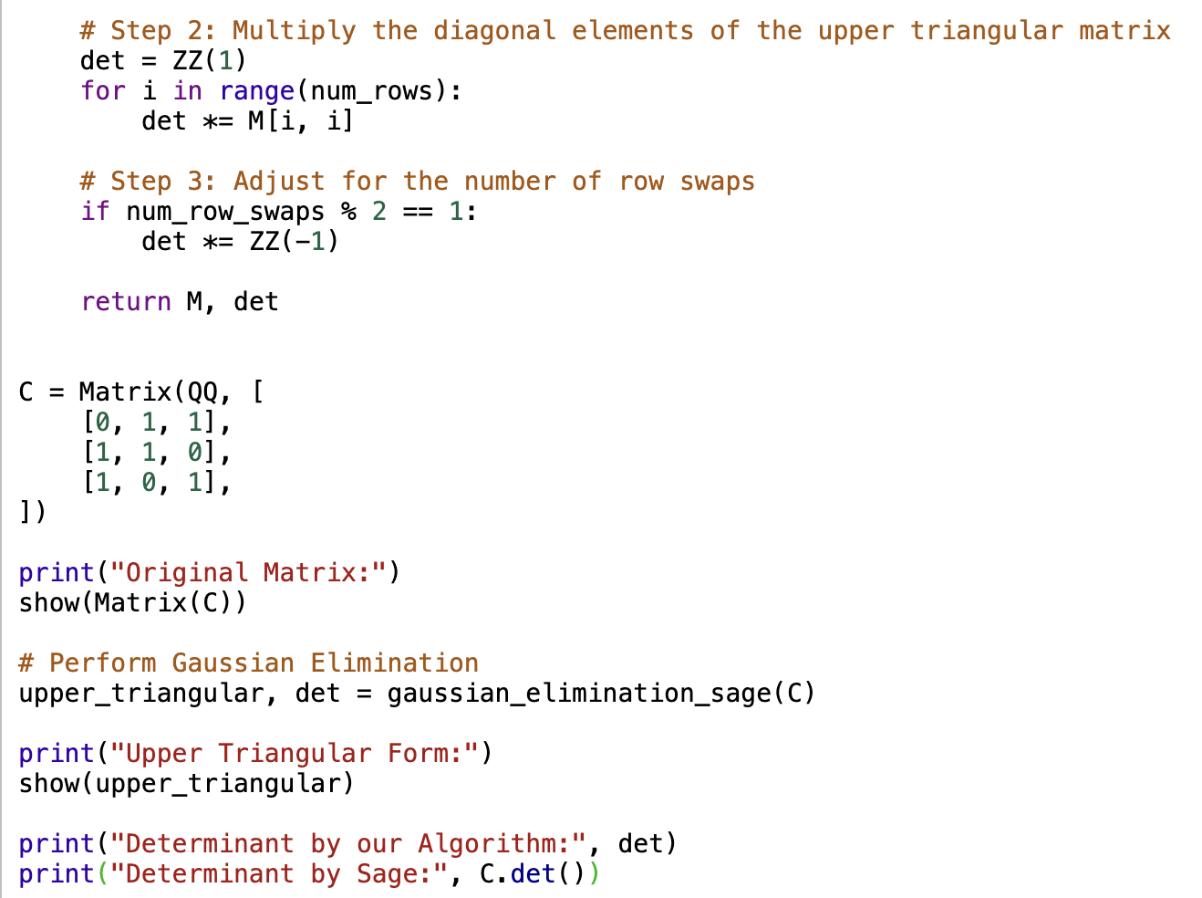
Code to calculate the Determinant of a Matrix

Slide 15
Thank you for your attention!
Gauss algorithm

